Slide 1
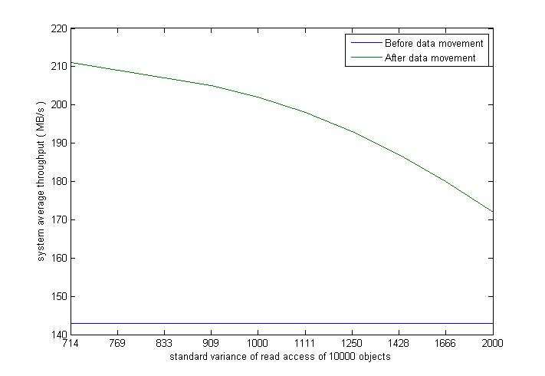
System throughput of normal distribution input

Slide 2
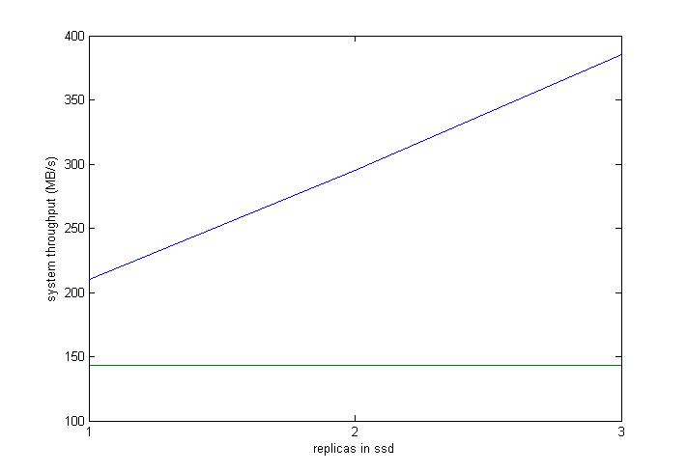
System throughput for different number of replicas in ssd

